Slide 1
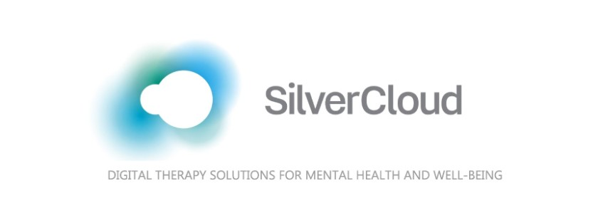
Silvercloud
Silvercloud is a free app to help students manage:
Stress
Anxiety
Body Image
Depression
It can be used with therapy.
It is designed to take 30 minutes per week for 8 weeks.
Silvercloud can include a human supporter.
”Healing takes time, and asking for help is a courageous step.” -Mariska Hargitay

Slide 2
Where do I get it?
Silvercloud is free for BYU students.
To enroll or to ask questions, email silvercloud@byu.edu
For more information, visit https://caps.byu.edu/silvercloud-online-self-help

