Slide 1
The Importance of
Exercise

Slide 2
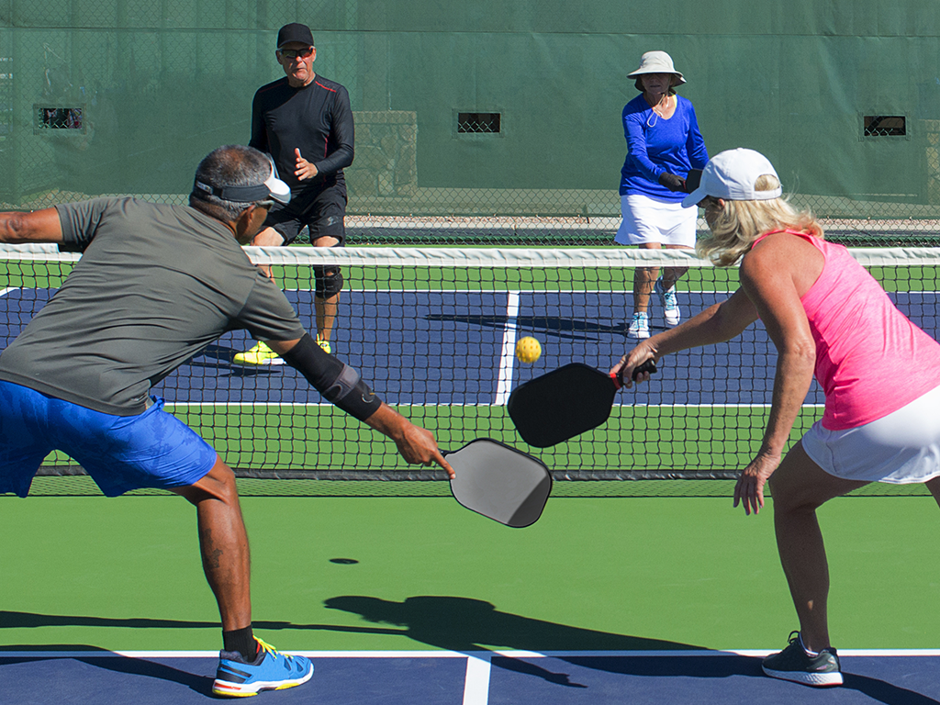
30 minutes of exercise can promote good mental health.
“Those who reported regular exercise were less likely to meet criteria in the previous year for diagnosis of major depression and a range of anxiety disorders.”
Saxena, S., Van Ommeren, M., Tang, K. C., & Armstrong, T. P. (2005). Mental health benefits of physical activity. Journal of Mental Health, 14(5), 445–451. https://doi.org/10.1080/09638230500270776

Slide 3
Think of a way you can incorporate exercise:
Dancing Swimming
Pilates Mountain Biking Frisbee
Karate Kick Boxing
Slacklining Night Games Kayaking
Running Basketball Walking Yoga
Spikeball Rock Climbing Hiking Jump Rope
Weight Lifting Volleyball Stretching Bowling
Badminton Zumba Baseball Hockey Golf

