Slide 1
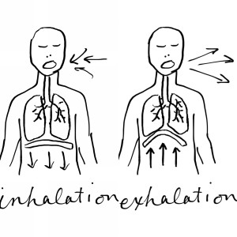
Paced Breathing
Breathing lower, slower, softly, and gently.
Notes:
Back Up link: https://caps.byu.edu/https:/brightspotcdn.byu.edu/8a/3d/89ffedb546edb199d4e09b71dca6/harp-arp-8-bpm.mp3
This is a suggested breathing exercise at 8 breaths/minute. Walk students through this exercise. Provide context before playing the audio clip by going over the benefits listed in the text below it.

Slide 2

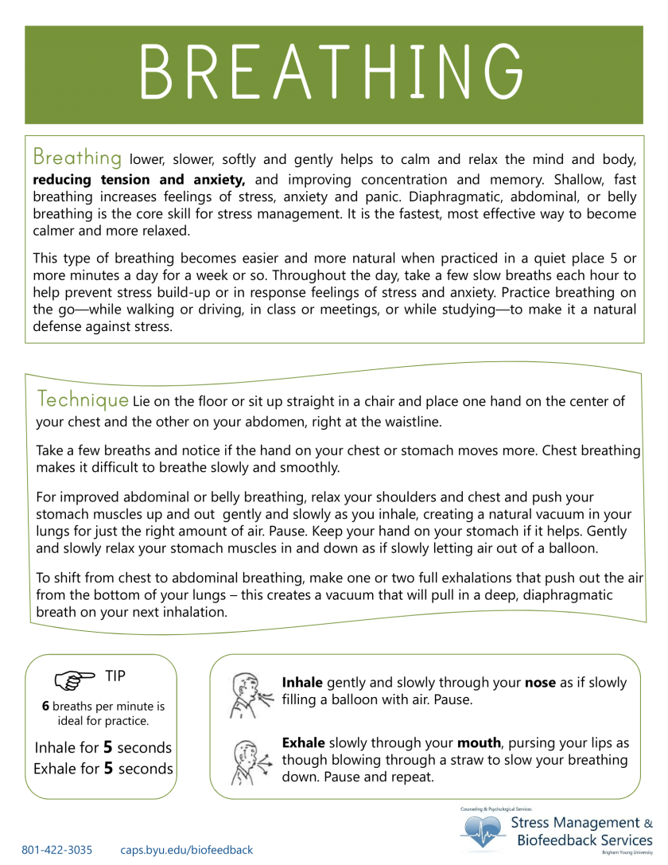
Validate yourself with words like:
Low
Slow
Soft
Gentle
Capable
Warm
Comfortable
Allow
Flow
Aware
Avoid words like:
-Try
-Must
-Should
-Need
-Have
-Deep
-Quick
Video Link: https://www.youtube.com/watch?v=44cs_7RIqTA

