Slide 1

Mindfulness
The goal of any mindfulness technique is to achieve a state of alert, focused relaxation by deliberately paying attention to thoughts and sensations without judgement. This allows the mind to focus on the present moment.
Notes:
Take a moment to introduce the topic of mindfulness to class members. You may use the definition provided, or ask for volunteers to describe their experience.

Slide 2
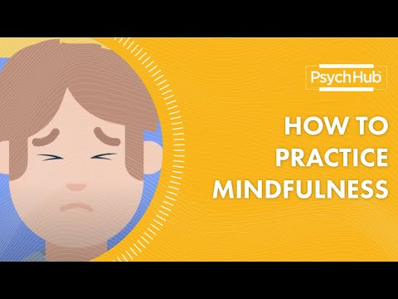




Let’s practice!
https://youtu.be/bLpChrgS0AY
(4 minutes)
Please be serious and considerate while we try this exercise.
If you enjoyed this exercise, consider downloading one of these apps:
Notes:
Invite your students to participate in the 5 minute mindfulness youtube video. Encourage them to download one of the following apps afterwards, to increase their mindfulness.

