Slide 1
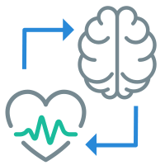
Biofeedback Lab
The word Biofeedback means "feedback from the body.”
Biofeedback training can help us learn to respond to the body's stress signals before they become too intense.
Specifically, Biofeedback training can:
Increase internal awareness of stress and tension in the body and mind
Teach us to calm down quickly and easily
Improve mental clarity, concentration, and memory for peak performance
Develop the ability to release tension and stress

Slide 2
Making an Appointment at the Biofeedback Lab
At the Biofeedback Lab, they use instruments and programs that measure stress and tension in the body (measuring indicators such as heart rate/rhythms, sweat gland activity, hand temperature, muscle tension). This live biofeedback information is displayed in real time on a computer screen.
To make an appointment, call 801-422-3035 and request a Biofeedback appointment.
For more information, visit https://caps.byu.edu/biofeedback

