Slide 1
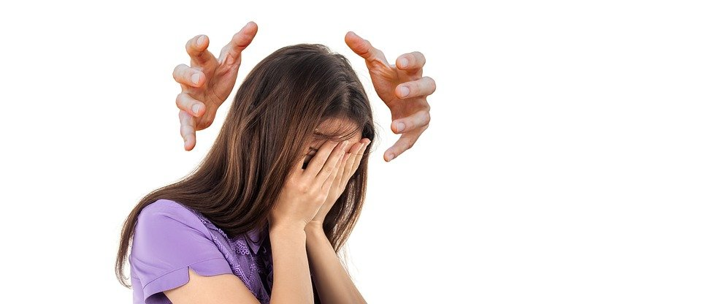
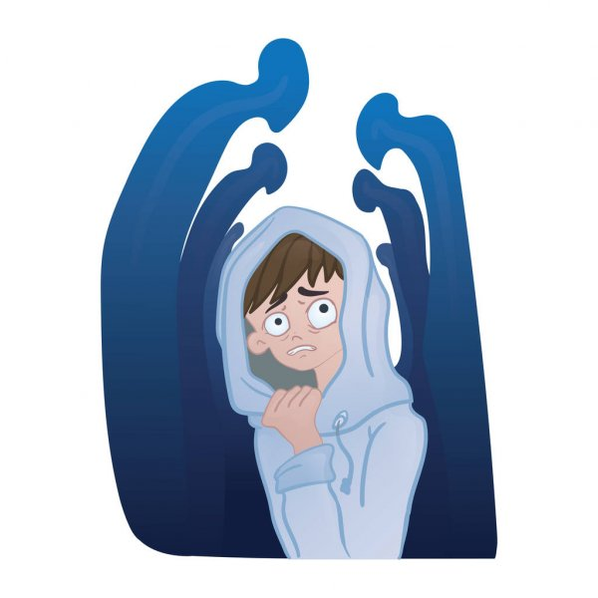
Social Anxiety Disorder

Slide 2
What is Social Anxiety?
Social Anxiety is a type of anxiety characterized by feelings of fear and anxiety in many social situations.
Social Anxiety is the fear of being judged, humiliated, or rejected by others, which leads to people with social anxiety avoiding social situations.

Slide 3
Symptoms
&
Signs
Having trouble breathing when surrounded by people
Feeling scared that those around you are judging you
Being very self-conscious in front of others
Avoiding areas or situations where there will be large groups of people
Feeling sick around others
Feeling as though your mind has gone blank
Source: https://www.nimh.nih.gov/health/publications/social-anxiety-disorder-more-than-just-shyness/

