Slide 1
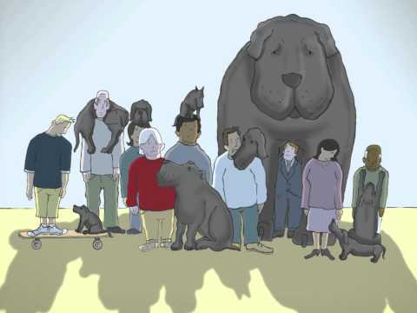
Depression

Slide 2
What is Depression?
Major Depressive Disorder (MDD), also called clinical depression, is a mood disorder characterized by several distressing symptoms that impact an individual’s ability to function in daily life.
Signs and Symptoms:
Persistent sad, anxious, or “empty” mood
Feelings of hopelessness or pessimism
Feelings of guilt, worthlessness, or helplessness
Loss of interest or pleasure in hobbies or activities
Decreased energy, fatigue, or being “slowed down”
Difficulty concentrating, remembering, or making decisions
Difficulty sleeping, early-morning awakening, or oversleeping
Appetite and/or weight changes
Thoughts of death or suicide or suicide attempts
Restlessness or irritability
We all experience sadness (and the other listed symptoms) at some point in our lives.
What makes clinical depression different is that the symptoms are persistent (for at least 2 weeks) and they impact a person’s ability to function.
https://www.nimh.nih.gov/health/publications/depression/index.shtml

Slide 3
Other types of depression
Persistent depressive disorder (dysthymia): having symptoms of depression that last for at least 2 years. A person diagnosed with this form of depression may have episodes of major depression along with periods of less severe symptoms.
Perinatal Depression: Women with perinatal depression experience full-blown major depression during pregnancy or after delivery (postpartum depression).
Seasonal Affective Disorder (SAD): SAD is a type of depression that comes and goes with the seasons, typically starting in the late fall and early winter and going away during the spring and summer.
For more information, or to get help if you or someone you know is struggling with depression, go to caps.byu.edu or call the CAPS office at 801-422-3035
https://www.nimh.nih.gov/health/publications/depression/index.shtml

