Slide 1
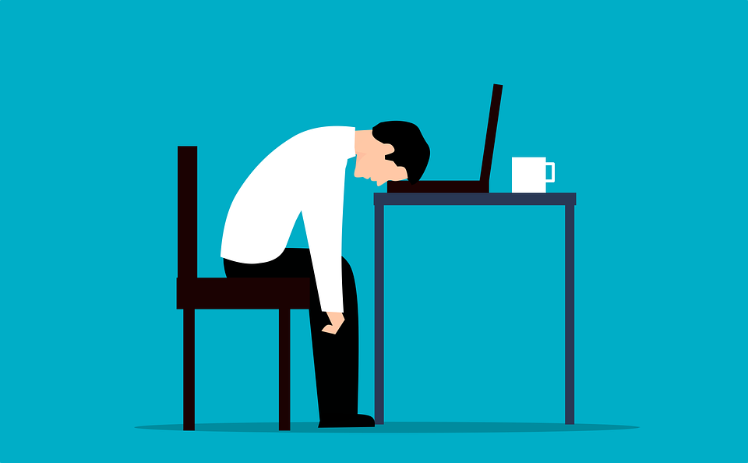
Burnout: A College Student’s Worst Best Friend
What is burnout?
Burnout is defined as a state of exhaustion caused by an excessively long period of prolonged stress.
Burnout is most commonly caused by excessive stress from work, including work as a college student
Source: https://www.helpguide.org/articles/stress/burnout-prevention-and-recovery.htm

Slide 2

Burnout: Symptoms and Solutions
Symptoms
Experiencing frequent exhaustion
Loss of motivation
Procrastination
Decreased life satisfaction
An increasingly negative outlook
Isolating yourself from others
Change in eating or sleeping habits
Experiencing intense self-doubt and fear of failure
Solutions
Reach out to others for help and support
Work to find balance in your life
Nourish your creativity and passions
Set aside time for yourself
Exercise regularly
Understand and accept your limits
Remember that it’s ok to take breaks and take time off

