Slide 1

Self-Compassion
The act of extending compassion to oneself in instances of perceived inadequacy, failure, or general suffering.

Slide 2
Three Parts of Self-Compassion
Self-kindness: being warm towards oneself when encountering pain and personal shortcomings, rather than ignoring them or hurting oneself with self-criticism.
Common humanity: recognizing that suffering and personal failure is part of the shared human experience, rather than reverting to isolation.
Mindfulness: taking a balanced approach to one’s negative emotions so that feelings are neither suppressed nor exaggerated. Mindfulness is a non-judgmental, receptive mind state in which individuals observe their thoughts and feelings as they are, without trying to suppress or deny them.
Notes:
Broken down definitions and parts based on the writings of Dr. Kristin Neff.

Slide 3
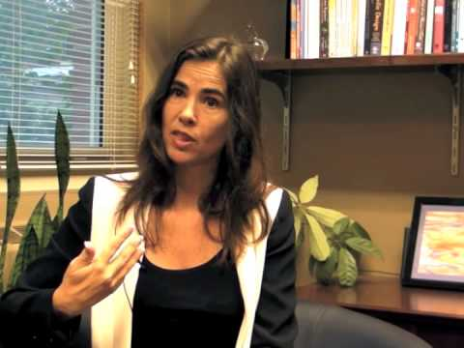
A few ideas for practice:
https://youtu.be/Qes9HoxfkE0

