Slide 1

Savoring
Savoring is defined as attending to, appreciating, and enhancing positive experiences that occur in one’s life.

Slide 2
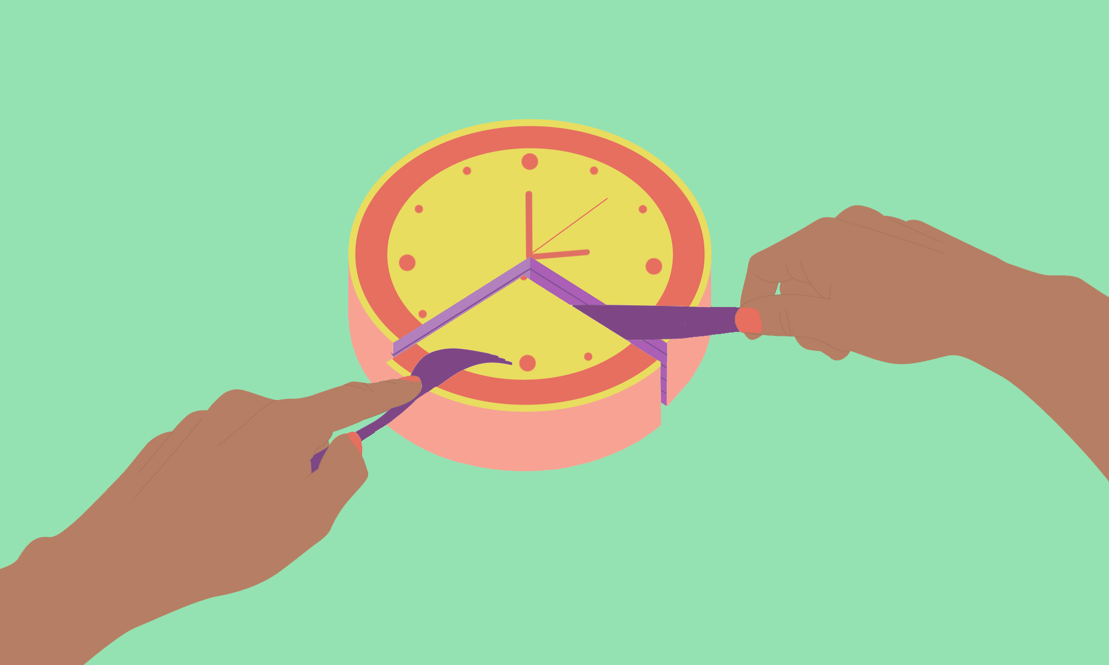
Savoring Explained
There are three types of savoring:
Savoring the past, also known as reminiscence. For example, remembering funny moments from school with a friend.
Savoring the present or savoring the moment. For instance, enjoying a new meal by drawing your attention to the flavors and smells.
Savoring the future, also referred to as anticipation. For example, visualizing the trip you have planned with your partner for this upcoming weekend.
Preconditions to savoring:
Being able to connect to the present moment
Freedom from urgent social responsibilities
Basic physical and psychological needs are covered
Presence of mindfulness and meta-awareness regarding positive experiences

Slide 3
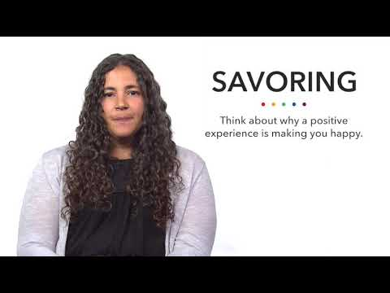
https://www.youtube.com/watch?v=AEY8vjAhQ6Y

Slide 4
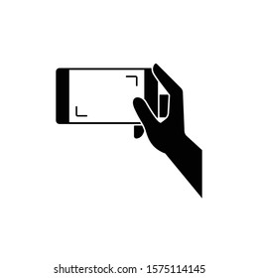
Sav(or) for Later
One of the most interactive ways to savor is to use your senses. Commit to practice today, at your next free moment (even if it’s just a minute or two)!
Find a favorite location or a place that brings your peace.
Remember the preconditions of savoring, and make sure you are in a good headspace.
Disconnect from anything that may be distracting you or drawing your attention away from the present moment.
Use your senses - Look, listen, touch, smell, and taste (if applicable) what is around you. Be intentional.
Reflect after your experience. How was this savoring experience different from your typical experience in this environment?
Notes:
For more information on savoring, visit the Positive Psychology website at this link: savoring

