Slide 1
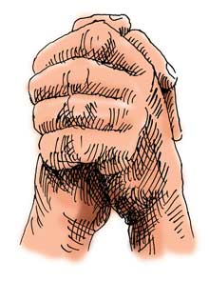
Gratitude
the quality of being thankful; readiness to show appreciation for and to return kindness.
How do you express gratitude?
Notes:
Introduce the topic of gratitude. Consider having a class member read the definition, or ask for volunteers to provide their own definition. Take a minute to ask or encourage students to discuss how they express gratitude regularly.

Slide 2
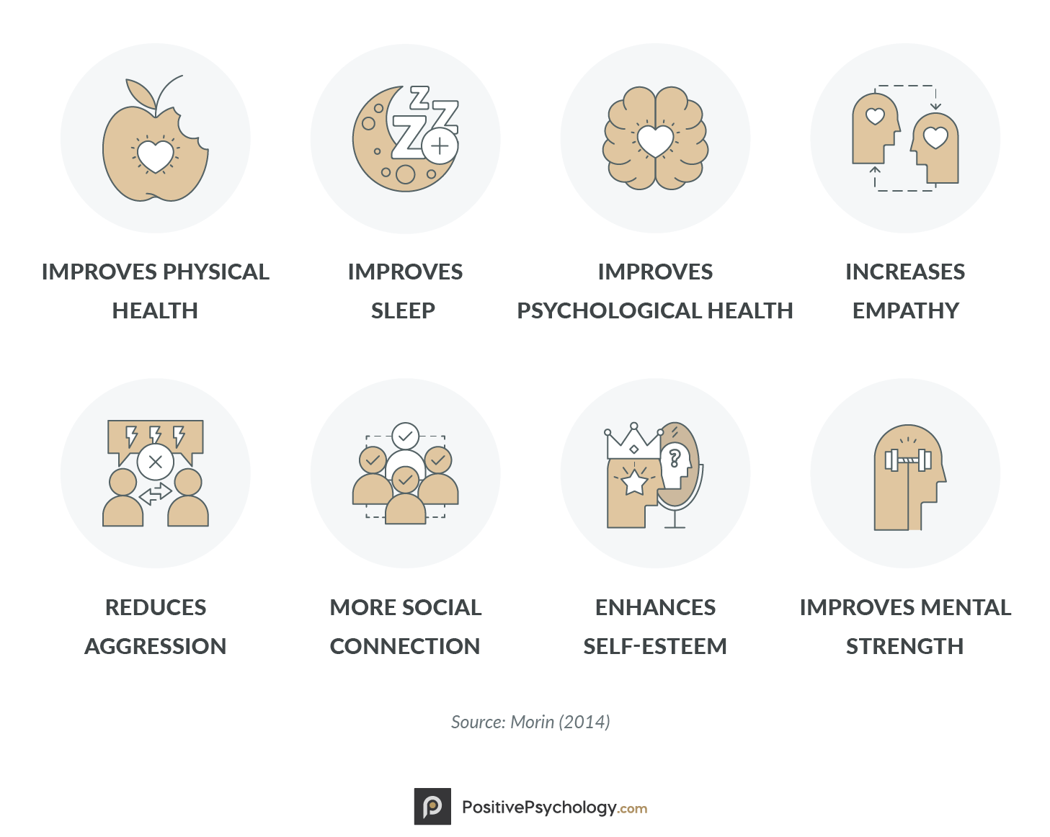
Let’s be grateful together.
Let’s try a new way to express our gratitude together:
Take out a piece of paper and something to write with.
In the next 2 minutes, start sketching out 2-3 things that you are grateful for currently.
  Preferably related to things that happened to you this week!
When the 2 minutes are up, share your sketches with your neighbor OR hold them up to your ZOOM camera so your classmates can see.
If time allows, volunteer to share your art and explain your thought process.
Notes:
Take a moment to share some of the benefits of expressing gratitude listed above. Share a personal experience, if desired. Invite students in person or virtually to complete the two minute activity listed above. Encourage students to continue to find new and creative ways to think about AND express gratitude regularly.

