Slide 1

Self Care: Classical Music
Listening to classical music can have lots of positive effects! Here are just a few:
It can help lower stress levels
It fosters creativity
Listening to it before bed helps you sleep better
It increases productivity

Slide 2

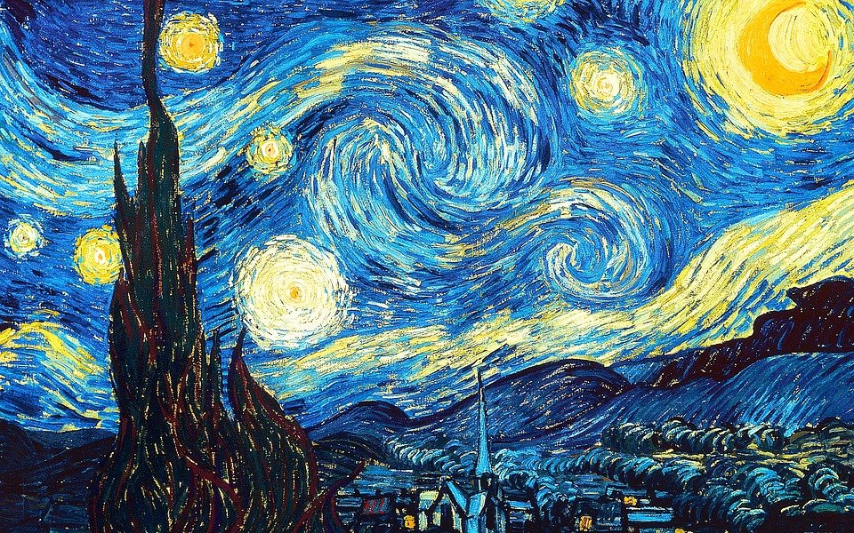
Here’s an activity! As you listen to a piece of classical music, allow yourself to ponder, reflect, and relax. Here’s a few pieces to choose from:
Chopin - Nocturne op. 9 No. 2: https://www.youtube.com/watch?v=9E6b3swbnWg
Debussy - Clair de Lune: https://www.youtube.com/watch?v=XkgyOZxIw0k
Beethoven - Fur Elise: https://www.youtube.com/watch?v=wfF0zHeU3Zs

