Slide 1

What is my
best possible self?
Notes:
Invite students to participate in a 5 minute activity where we create visions, goals, and plans for our best possible selves.

Slide 2
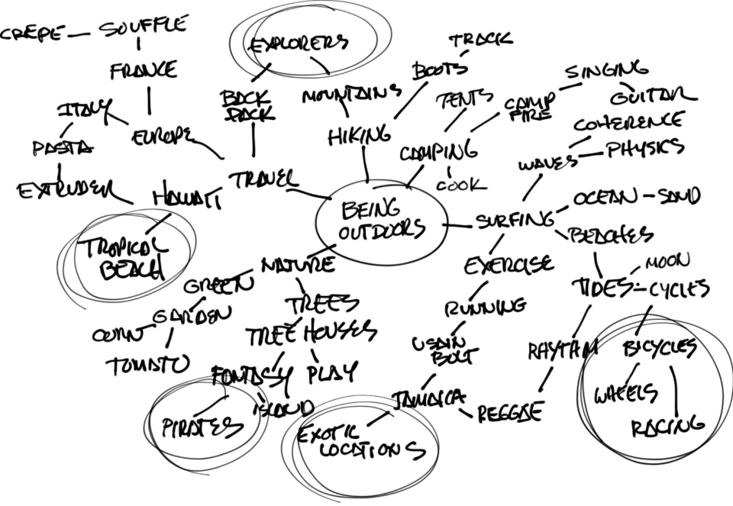
Let’s Put Together a Vision
Take 5 minutes to write down the best possible outcome for 5 or 10 years from now.
Imagine that all your goals and wishes came true, and the best possible outcomes were achieved.
Include these details in your outline.
Notes:
Let students work quietly for 5 minutes to completed the above-listed tasks.

Slide 3
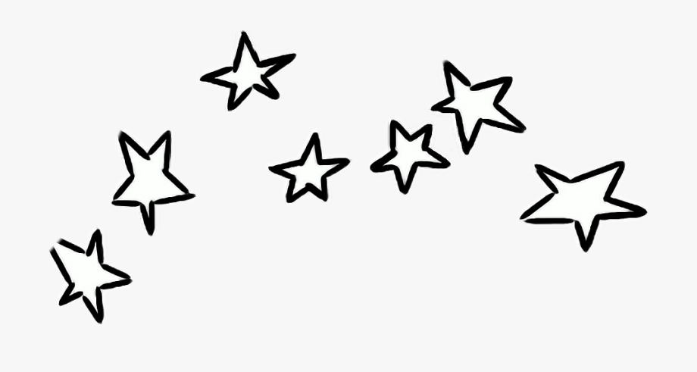
What would your life be like?
Notes:
Ask for volunteers to share.

Slide 4
What goals can you set now to work towards your best possible self?
Notes:
Share insights on the importance of goal-setting and vision-focus.

