Slide 1

Do you like to journal?
Why?
Journaling involves the regular writing and exploration of thoughts and feelings surrounding the events of your life.
Notes:
Consider asking class members to discuss this question briefly with their neighbor or to self-reflect. You may also ask them to consider the last time they seriously took time to journal and how they felt.
Photo Source:
https://divyamsdoodles.tumblr.com/post/181376053964/the-stack-art-journals-i-have-worked-in-over-the

Slide 2
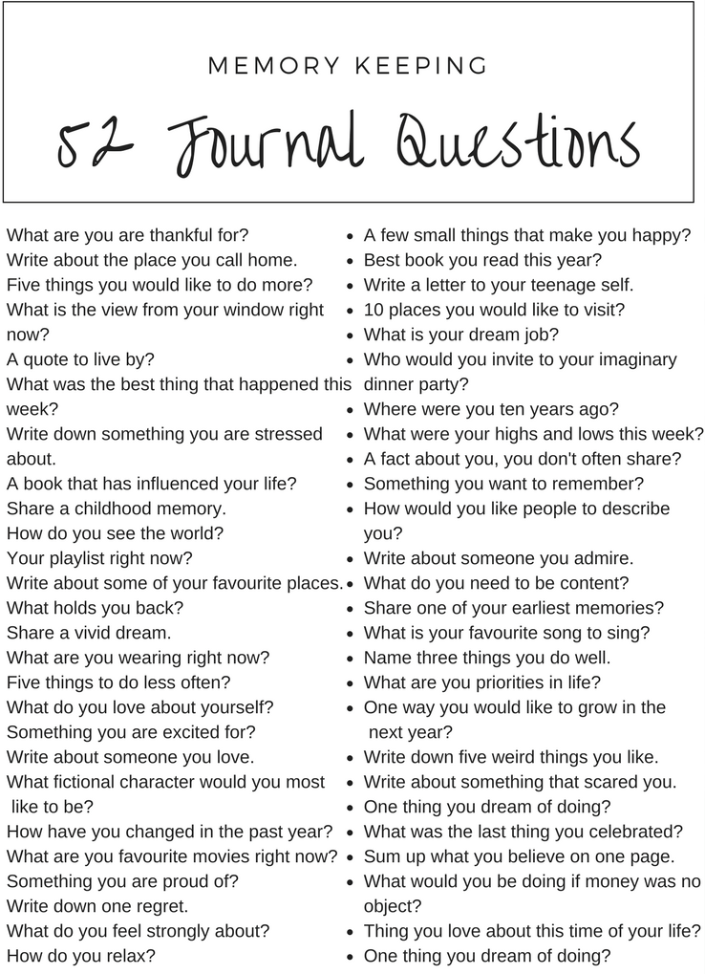
Benefits of Regular Journaling
Regular journaling has proven to help individuals:
  Manage anxiety
  Reduce stress
  Cope with depression, fears, concerns, etc.
  Organize and prioritize
  Access an outlet for positive self-talk and gratitude
  Regularly reflect and meditate
  Better articulate feelings and emotions
Find a writing habit that works best for you. While some may prefer writing daily, others may prefer weekly or monthly. While some may prefer handwritten entries, others may consider keeping a digital record or downloading an app. It doesn’t matter what you prefer, as long as you start somewhere!
Consider collecting new and interesting journaling topics and note how you feel as you participate.
Notes:
Introduce students to some of the mental health benefits of journaling listed above. Consider sharing a personal experience if you desire. If time permits, invite students to pick one prompt from the photo above (or think of their own custom prompt) and encourage them to write about it at their next journaling session.
Sources:
https://www.urmc.rochester.edu/encyclopedia/content.aspx?ContentID=4552&ContentTypeID=1
https://www.pinterest.co.uk/pin/280982464232530797/

